Slide 1
Bay Area Transformation Partnership
Advantages of
Cross-Organizational Use of Secure Texting
LifeSpan – Post-Acute Leadership Summit
May 16, 2017

Slide 2
Presenters
Dave Mooradian, MD, Chief Medical Information Officer, Emergency Department, Anne Arundel Medical Center
Reshma Modi, DO, Medical Director, Skilled Nursing Facility Provider, Adfinitas Health
Erin Devine, MBA, BSN, RN, CDON, UM Baltimore Washington Medical Center High Risk Care Coordinator, Skilled Nursing Facilities
Cindy Gingrich, MSIM, PMP, CPHIMS - BATP Project Management Consultant (Anne Arundel Medical Center & UM Baltimore Washington Medical Center)

Slide 3
Disclaimer
Presenters have no conflicts of interest related to the products or services contained in this presentation.

Slide 4
Objectives
The Bay Area Transformation Partnership (BATP)
  Who we are
  Secure Texting landscape
How we are using secure texting to improve communication as patients move across care settings
Case Study: ‘Before’ and ‘After’ secure texting
  Adfinitas Health providers in the Skilled Nursing Facilities (SNF) and
  Emergency Departments (Anne Arundel Medical Center, University of Maryland Baltimore Washington Medical Center)
Single technology solution, multiple organizations (CRISP-hosted)
Review Additional Use Cases
How to sign-up for access to cross-organizational secure texting

Slide 5
Bay Area Transformation Partnership
HSCRC funded grant to improve care coordination between hospitals and community partners, resulting in better chronic care management and cost savings
Anne Arundel Medical Center
University of Maryland Baltimore Washington Medical Center
Community Care Management Agencies
  The Coordinating Center
  Department of Aging & Disabilities
Adfinitas Health – Skilled Nursing Facility Providers
Physician House Call Service (Capital Coordinated Medicine)
Behavioral Health resources

Slide 8
Secure Texting
Skilled Nursing Facility Provider to/from
Emergency Department Provider

Slide 9





Before Secure Texting
I’ll take a message and leave a note for the doctor
Wait on Hold
1
2
3
…
…….........
- Non-provider interpretation
- Sometimes message never reaches the right ER doctor
4
5
Send the patient and paperwork to the ED
What does this note mean?
I have questions
Do I call the facility and try to find this provider?
I don’t have time or know whether it would help. I’ll admit and treat.
Shift changes at the SNF?
Shift changes in the ER?
Which ER doctor will see the patient?

Slide 10


After Secure Texting
3
1
2
Fast Efficient Direct
…
AAMC ED Attending
Or
UMBWMC ED Attending
No more waiting on hold to leave a message!
4
ED Doc reads ASAP (no phone call interruption)
Direct response to SNFist
No interpretation by intermediary
I know who you are and we share this patient ‘together’
Can easily ‘call’ or ‘text’ the SNFist
Can pass the message at change of shift
Direct connection benefits occur ‘days’ afterward (i.e. medication questions)
Send the patient and paperwork to the ED

Slide 11
Example – SNFist to ED Provider Communication
Originally from: Melissa Barksdale, CRNP Date: 5/4/17 11:24 PM
Hello. ‘<Patient>’ DOB: ‘x/x/x’ is coming from Heritage Harbour SNF for Left hip wound large amount of bleeding that is pulsating. Nurse unsure if it is an old surgical wound. Dx Left hip wound infection, could not obtain much more hx than that as the nurse and wound nurse are trying to maintain pressure to this pulsating wound. BP 101/50, P 103, Pulse Ox 95% on RA. Thank you.
Originally from: David Mooradian Date: 5/5/17 2:02 AM
Looks like decub. No bleeding here. May need to follow with wound center
Dave Mooradian, MD, Chief Medical Information Officer, Emergency Department, Anne Arundel Medical Center

Slide 12
Example – SNFist to/from ED Providers
SNF Provider
To: ED Attending UMBWMC Hi, Taana Viviano here at severna park. Sending in <Patient Name> by 911 for witnessed unresponsive episode sitting in WC and then gen T-C sz activity for approx 2 min. All VSS, bs 140. After 5 min started to open eyes to name. Diaphoretic. +h/o cva with chr L paresis. Call with any questions. 443-534-0575
ED Provider # 1
From: Chirag Chaudhari, MD
Date: 5/1/17 1:27 PM
Got it thanks.
Shift Change in the ED
(Doc #1 passes text to Doc # 2 before leaving)
ED Provider # 2
From: Bethany Radin, DO Date: 5/1/17 5:04 PM
Hi. Dr Radin. I just saw <Patient Name>. No further seizures. No obvious cause other than his prior stroke. Started him on keppra. To follow up w dr Singh neurology
From: Taana Viviano, MD Date: 5/1/17 5:06 PM
Ok thanks

Slide 13
Example: Post hospital discharge - SNFist to/from Hospitalist
From: Reshma Modi, DO Date: 4/13/17 3:08 PM
Hi Elizabeth This is Reshma Modi from Waugh Chapel I was told you were trying to get a hold of us regarding a MOLST form for a patient ....
From: Elizabeth Young, PA-C Date: 4/14/17 6:39 PM
Hello! Yes thanks, Dr Modi for getting back to me. I discharged patient [x] to Waugh chapel. The person who admitted him discussed/filled out a MOLST with him, but apparently just the front and the Care manager advised me she was contacted to get the back portion filled out. I wasn't quite sure how to go about discussing it with him to complete it since I have no contact information while at rehab so the care manager suggested that possibly one of the clinicians at Waugh chapel could go over it with him. I'm not sure if that is a possibility, but I appreciate your assistance either way. Thanks again
From: Reshma Modi, DO Date: 4/18/17 12:17 PM
Hi Elizabeth
Sorry for late response Don't worry , we took care of it :)
Dr. Reshma Modi, Adfinitas Health Provider, Skilled Nursing Facility

Slide 14
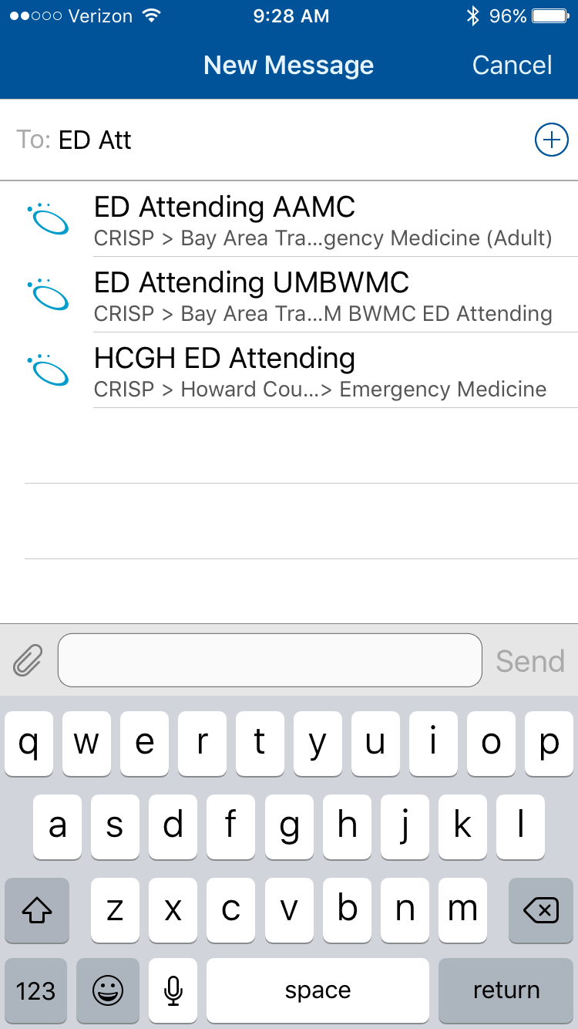
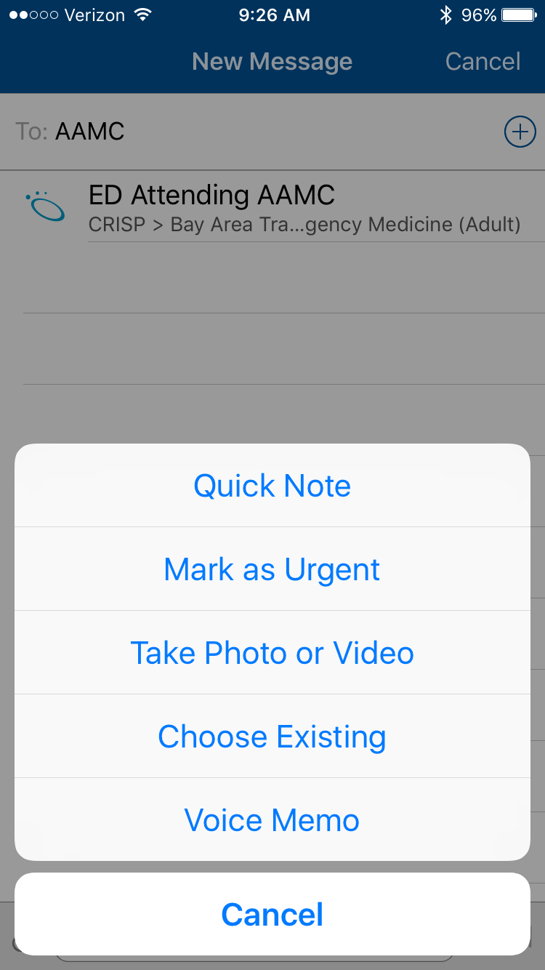
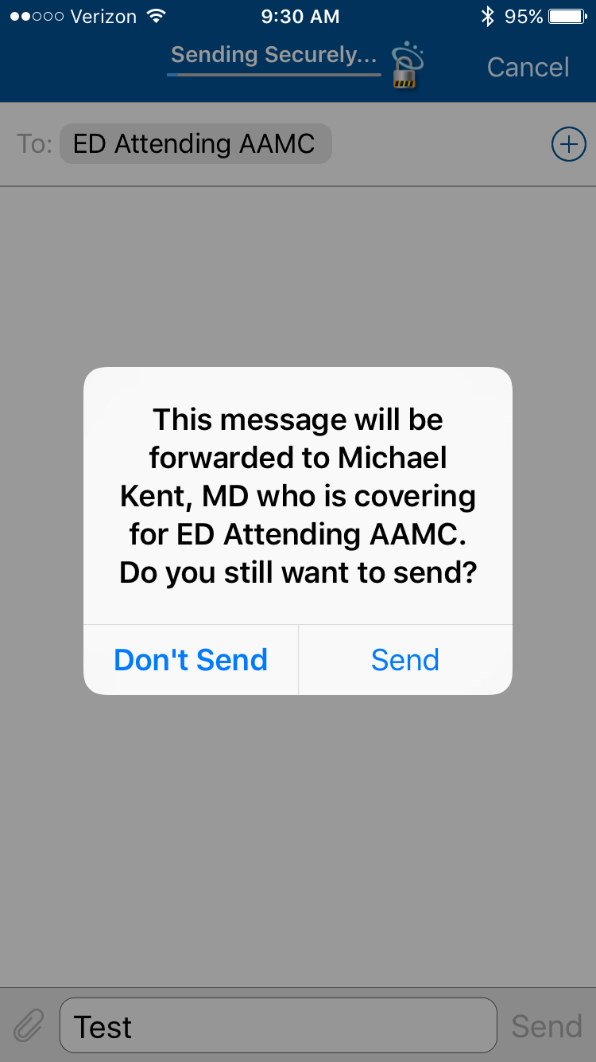
H
O
W
T
O
T
E
X
T
Search for and select
ED Attending
at appropriate hospital
SNFist sees a message asking permission for the message to be forwarded to a specific ED Provider. Now they know who the ED Doctor is!
SNFist can type a text message, send a photo or video or send a voice message

Slide 15
How we do it
ED Administrative staff log in to the generic ‘AAMC ED Attending’ ID and set auto forward ‘on’ so that messages go directly to the ED provider who is in charge of receiving secure texts for that shift.
ED Provider logs in to their own Doc Halo account to receive the messages
SNFists can send to the generic ‘AAMC ED Attending’ or ‘UM BWMC ED Attending’ Doc Halo ID’s 7x24x365

Slide 16
CRISP-hosted Doc Halo Secure Texting
Enables multiple organizations to use the same software application
  Shared organization lists (i.e. phone book) so they can see who is on Doc Halo (organizations, departments, titles)
Collaboration -> We study and improve processes together
    Multiple EMR challenge
    Information needed by each role varies (we learn thru texting who needs what & when)
    Workflows
    Opportunities for improvement in communication, care coordination and avoiding preventable utilization

Slide 17
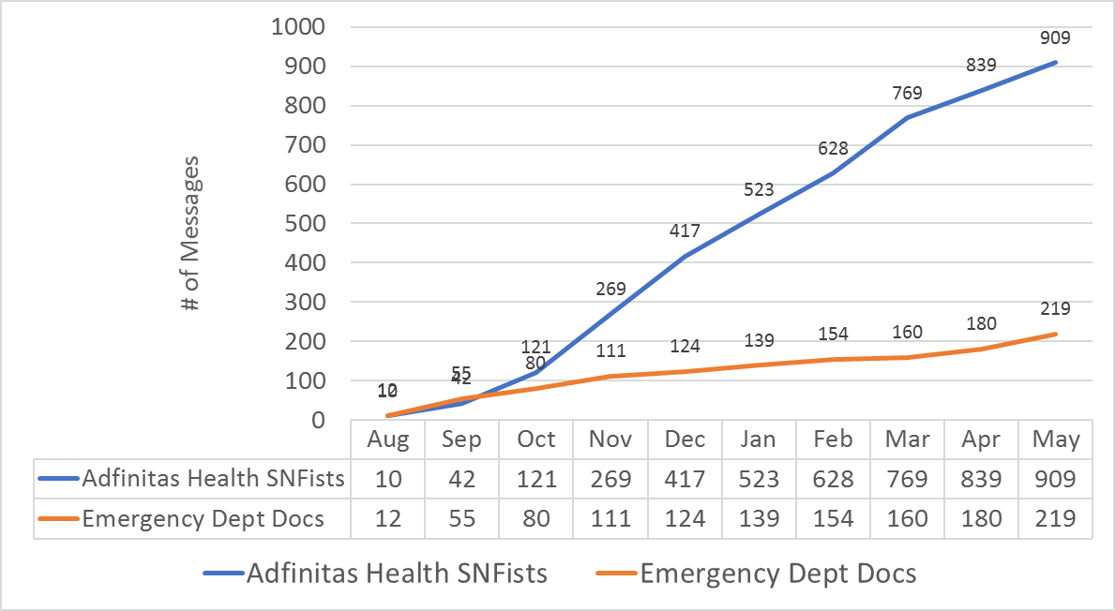
Secure Texting
Skilled Nursing Facilities
and Emergency Department

Slide 18
Additional Use Cases
Community care manager receiving Encounter Notifications via Doc Halo
ED care manager to community care manager
SNF Social Worker to/from Community Care Manager
ED to Specialists for Urgent Follow-up (i.e. Cardiology)
Specialist consultation from ED, Hospitalist or SNF
Complimentary to Telemedicine
Inter-organizational secure texting
Erin Devine, MBA, BSN, RN, CDON, UM Baltimore Washington Medical Center High Risk Care Coordinator, Skilled Nursing Facilities

Slide 19
Example: Encounter Notification for a patient discharge from hospital via secure texting
5/15/2017 6:32 AM
Fwd: User , API
Patient Information:
Patient Name:
Gender: Female
DOB:
Address:
Home Phone:
Work Phone:
Cell Phone:
Facility Information:
Hospital/Org. Name: Baltimore Washington Medical Center
Hospital MRN: xxxxxx
Event: Emergency Discharge
Event Time: 05/15/2017 06:18:50
Additional Information:
Admit Source:
Admit Reason:
Death Indicator: N
Death Date:
Diagnosis Code:
Diagnosis Description:
Discharge Disposition: *O/P FINAL/HOME
Discharge To Location:
Hospital Service:
Race: White
Ethnicity:
Past Encounter Information:
Past Emergency Visits: 1
Past Inpatient Visits: 0
Your Facility Site:
Your Facility MRN:

Slide 20
Access to CRISP Doc Halo
Focus is on cross-organizational use
If you are part of a regional partnership, please contact your project manager
If you are not part of a regional partnership, please contact the CRISP Support Team at:
support@crisphealth.org
or call 877 952 7477
and ask about obtaining access to Doc Halo secure texting for
cross-organizational use

Slide 21
Bay Area Transformation Partnership (BATP)
Advantages of
Cross-Organizational Use of Secure Texting
Thank you

Slide 22
Extra slides

Slide 23
After Secure Texting
SNFist can quickly and securely text the right ER Doctor , establishing a direct communication link.
ED provider can respond as soon as possible via text or by pressing the phone icon in the text message.

