Slide 1
Home Health Data: Tracking, Trends and Truth
Leadership Summit - May 16, 2017

Slide 2
Objectives
TRACKING: Where are the data?
TRENDS: What do the data mean?
TRUTH #1: How do the data effect us?
TRUTH #2: What do we do with the data?
TRUTH #3: Who wants all that data?
Notes:
Tracking data provides trends over time, and helps guide an agency with a plan of improvement to meet Medicare’s THREE PART Aim by benefitting patients with quality care, reducing avoidable hospitalizations and keeping patients in their homes.

Slide 3
Where are the data?
Home Health Quality Improvement Initiative
Reports created monthly using OASIS data:
Acute Care Hospitalizations (ACH);
Oral Medications Management;
Influenza Immunizations;
Pneumococcal Immunizations;
Cardiovascular Risk (All Population & At-Risk Population)
http://www.homehealthquality.org
Create a free account for total access
Notes:
Home Health Quality Improvement: reports are available via the secure HHQI Data Access System around the 23rd of each month and require no additional work on your behalf.

Slide 4
HHCAHPS
Home Health Care Consumer Assessment of Healthcare Providers & Systems Survey or "HHCAHPS," is designed to measure the experiences of people receiving home health care from Medicare-certified home health agencies.
https://homehealthcahps.org

Slide 5
State Survey Agency
Office of Licensing and Certification Programs Maryland Department of Health and Mental Hygiene
The Office of Health Care Quality (OHCQ) is the agency within the Department of Health and Mental Hygiene charged with monitoring the quality of care in Maryland's health care facilities and community-based programs. It​​ is tasked with conducting inspections to certify Home Health Care Agencies for Medicare and Medicaid compliance and to investigate and validate complaints made by individuals.
http://health.maryland.gov/ohcq/Pages/Home.aspx

Slide 6
Medicare.gov
Home Health Compare: (data last updated April 12, 2017)
Scores how well home health agencies care for their patients
Shows use of best practices in caring for patients and patients’ improvements
Reports what patients said about their recent home health care experience
Star Ratings: agency performance based on 9 individual quality measures
3 Process Measures and 6 Outcomes Measures
CASPER (Certification and Survey Provider Enhancement Reports):
OBQI reports (case mix and outcomes)
OBQM reports (adverse events)
Index Reports (tally)
HHA Provider reports (agency list, discharges, duplicate patient, error by field, month and message)
www.cms.gov/Medicare/Quality-Initiatives-Patient-Assessment-Instruments/HomeHealthQualityInits/Downloads/HHQICASPER.pdf
Notes:
Process of care measures – how often the agency: Initiated patient care in a timely manner; Provided patient/caregiver drug education on all medications; Ensured patients received flu vaccine for the current season. Outcome of care measures – how often the patient Got better at walking/moving around; Getting in and out of bed; Bathing themselves; Engaging in activity with less pain; Experienced less shortness of breath; Required acute care hospitalization. HOW OFTEN DO YOU ACCESS CASPER?

Slide 7
Medicare Data Sources
Outcome and Assessment Information Set (OASIS): forms the basis for measuring patient outcomes for purposes of Outcome-Based Quality Improvement (OBQI) and agency adherence to best practices for Process-Based Quality Improvement (PBQI)
Quality Improvement Evaluation System (QIES): encompasses all the aspects of data collection and reporting on home health agencies
Medicare Claims: data are used to calculate certain utilization-based home health quality measures and are reliable because providers are required to submit claims to get payment
Medicare works to be sure that the OASIS, QIES, and claims information are correct and current. However, recommends using it with other information gathered from the State Survey Agency, state QIO and other sources.
www.medicare.gov/HomeHealthCompare/Data/Data-Sources.html

Slide 8
Medicare FFS - Q3 2016 Claims Data
Data on discharges from MD hospitals to statewide home health agencies, based on either:
discharge destination code indicating HHA, or
HHA claims found subsequent to hospital discharge.
General analyses for readmission rates from HHA follow Medicare guidelines by searching for HHA services within 48 hours. A maximum threshold of 5 days was set for the time period in between discharge from hospital to start of the HHA claim in order to relate the two claims; if longer than 5 days, we considered HHA services as not received following discharge.

Slide 9
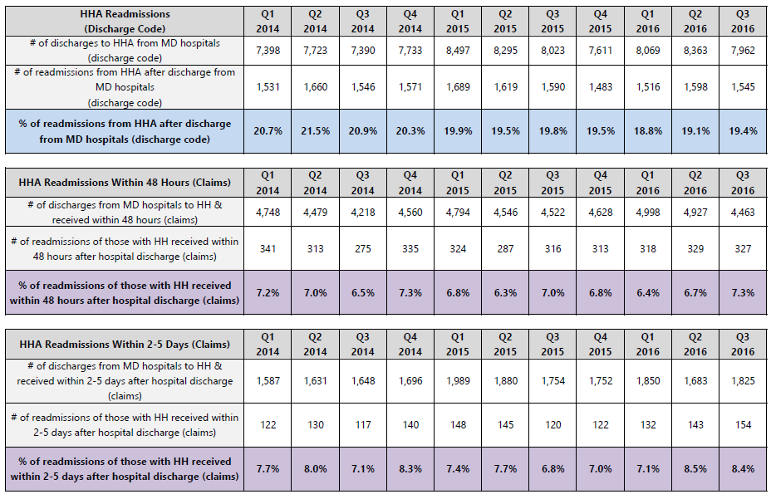
Maryland Medicare FFS HHAs Readmissions
Notes:
Q 3 2016 the # that did not receive HH within 5 days =

Slide 10
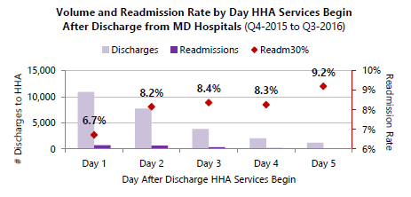
Medicare FFS - Q3 2016 Claims Data
Notes:
Based on claims; so if HH was received on Day 1 RA rate = 6.7%; but if HH starts day 5, likelihood of RA is 9.2%

Slide 11
Discharges and Readmits by Days

Slide 12
Medicare FFS - Q3 2016 Claims Data
Notes:
Discharge code says HH; but no claims were filed within 5 days; so we don’t know if they ever HH.

Slide 13
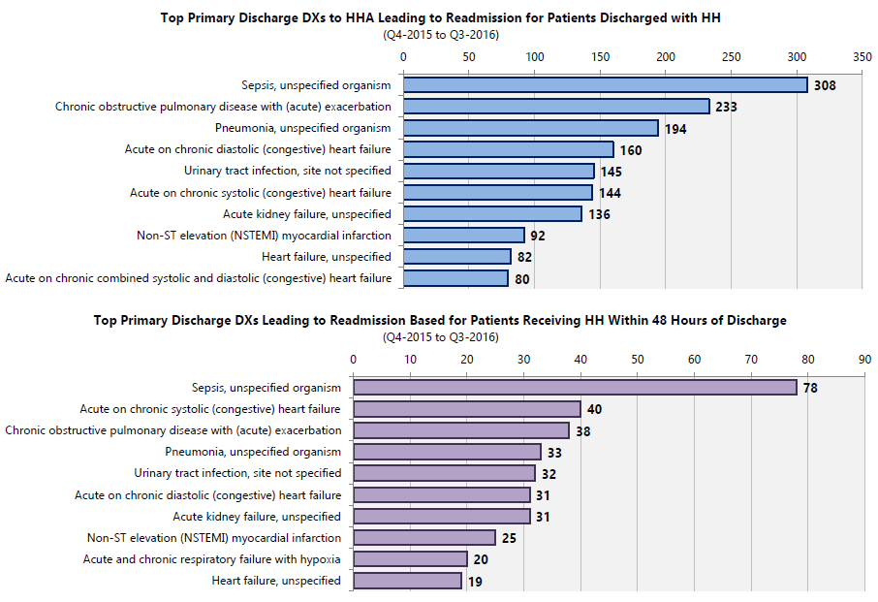
Medicare FFS - Q3 2016 Claims Data
Notes:
Data related to top diagnoses are based on the principal discharge diagnoses in the of ICD-10 codes on each claim. Top is based on discharge code. Bottom based on HH claims after discharge. Data Source: Medicare FFS Part A Claims

Slide 14
Medicare FFS - Q3 2016 Claims Data

Slide 15
What Do the Data Mean?
Data show where there are opportunities for improvement by:
Patient Satisfaction
Timeliness of SOC
Quality Measures
Diagnosis
Other?

Slide 16
How Do the Data Affect US?
The Bottom Line
Loss of business due to:
Reduced Patient Satisfaction Scores
Reduced Partner Referrals Due to High Readmissions
Reduced Payments Due to Poor Quality Care
Reduced Case Load Due to Untimely Start of Care

Slide 17
Now What?
Are You Suffering from a “DRIP”?
“Data-Rich; Information Poor!
What Do We Do With All That Data?
Where do You start?
Let’s begin by looking at Your data?
Where is there an opportunity for improvement?
Who can help with the “tests of change”?
What innovations/initiatives are proven?
How will You know what makes a difference?

Slide 18
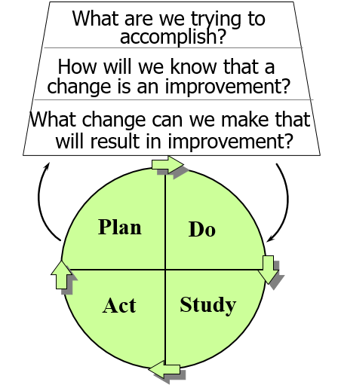
Using The Model For Improvement

Slide 19
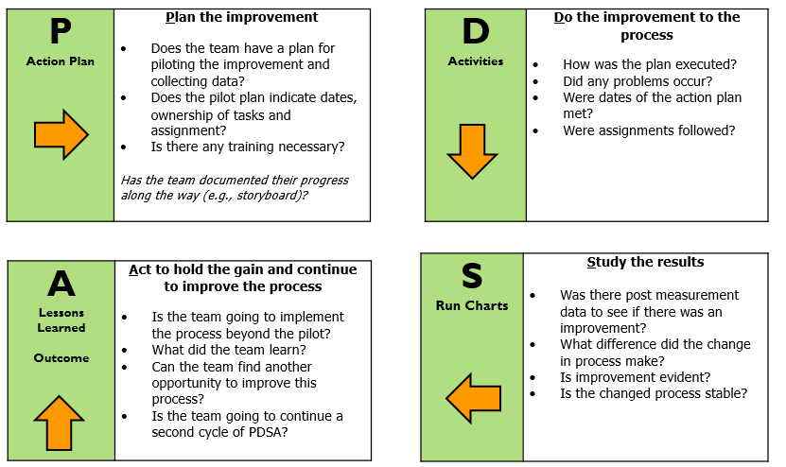
The PDSA Cycle

Slide 20
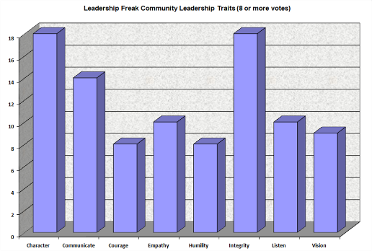
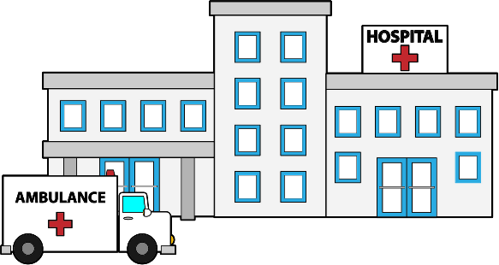
Quality Improvement
Suggestions?
Medication Compliance
Chart Audits
PCP
Involvement
Patient Education/Motivation
CASPER Analysis
Staff Education
Data Trends
Family
Engagement
Community Partners

Slide 21
Set SMART Goals
Specific: Objectives should be well-defined
Measurable: Objectives should have a benchmark and target to help determine whether the objective is achieved
Achievable: Objectives should be within reach
Relevant: Objectives need to be in line with organizational mission, vision, and goals
Time-phased: When will the objective be achieved

Slide 22
Resources
PAM: Patient Activation Measures
http://www.insigniahealth.com/products/pam-survey
RED: Re-Engineered Discharge
https://www.bu.edu/fammed/projectred/toolkit.html
BOOST: Better Outcomes by Optimizing Safe Transitions
www.hospitalmedicine.org
INTERACT: Interventions to Reduce Acute Care Transfers
https://interact2.net/tools.html
Motivational Health Coaching: http://www.healthcoachinstitute.com
RCA: Root Cause Analysis-Ask “Why” Five Times
https://www.ncbi.nlm.nih.gov/pmc/articles/PMC1292997/
Mobile Integrated Healthcare (MIH):
http://www.naemt.org/MIH-CP.aspx
TEACH BACK: http://www.teachbacktraining.org

Slide 23
What Else Can We Do With The Data?
Need ideas
The Breakthrough Series: IHI’s Collaborative Model
Model for Improvement: Rapid Cycle Testing (PDSA)
Care Bundles: Set of Successful Interventions
Hospital Standard Mortality Ratio (HSMR): Move Your Dot
The IHI Triple Aim: Concept Design
100,000 Lives Campaign: Six Patient Safety Practices
http://www.ihi.org

Slide 24
MORE INNOVATIONS
Offers an array of innovations by state, healthcare setting, clinical category, patient population, quality areas, and organizational processes.
https://innovations.ahrq.gov/narrow-by-subjects/?term=307

Slide 25
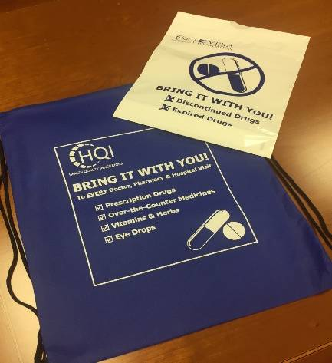
Health Quality Innovators’ Resources
HQI Resource Dashboard
Blue Bag Initiative
Notes:
On the left hand side of your folder are some other wonderful programs/tools/resources HQI can offer your practices….. Just wanted to make sure you had exposure….

Slide 26
Home Health Quality Improvement
HHQI University: Free eLearning continuing education (CE) courses
Best Practice Intervention Packages (BPIPs)
Performance Improvement Plan (PIP)
Quality Assurance Performance Improvement (QAPI)
http://www.homehealthquality.org
Create a free account for total access

Slide 27
Who Wants All That Data?
The Advantages of Good Data:
Stakeholders/Partners: What data elements are prioritized when building preferred networks?
Patients with Care Coordination Needs: Data can be used as the common language when communicating and collaborating across care settings.
Medicare: With reimbursement moving to value-based care across healthcare setting.
Consumers: Who have choice and choose quality care.

Slide 28
Contact HQI
Kelly Arthur, BS
Improvement Advisor- MD, Care Transitions
karthur@hqi.solutions
804-289-5344
Sheila McLean, MBA, LNHA, CPHQ
Vice President – Maryland
smclean@hqi.solutions
434-960-7854
Health Quality Innovators
www.hqi.solutions
301-744-8472

Slide 29
HQI|11SOW|20170509-185327
This material was prepared by Health Quality Innovators (HQI), the Medicare Quality Innovation Network - Quality Improvement Organization for Maryland and Virginia, under contract with the Centers for Medicare & Medicaid Services (CMS), an agency of the U.S. Department of Health and Human Services. The contents presented do not necessarily reflect CMS policy. HQI|11SOW|20170419-184634

