Slide 1


Factors Accelerating the Development of Preferred Post-Acute Provider Networks
Presented by
Bernie Galla, RN, BSN, MBA
&
Susan C. Westgate, MBA, MSW, LCSW-C

Slide 2


Introductions
Susan C. Westgate, MBA, MSW, LCSW-C
Co-Chair of the Skilled Nursing Facility (SNF) Collaborative
Sinai Hospital of Baltimore
Bernie Galla, RN, BSN, MBA
Director, Information Services
Enterprise Systems
LifeBridge Health

Slide 3
Program Overview
The following presentation will provide relevant and timely insights and discussion about:
The factors that are accelerating the development of preferred post-acute provider networks
The data elements and tools used to build and manage a preferred provider network
How building a common data exchange network and infrastructure advanced communication and collaboration across care settings
How relationship building and management with post-acute partners promotes program success

Slide 4

About LifeBridge Health
183,309 ED Visits
35,239 Surgical Cases
175,376 OP Clinical Visits
3,252 Births
9,959 Employees
4 Hospitals
100+ Locations
1,306 Beds
$1.6B
Health System
2,706
Physicians
14 residency & fellowship programs
Level II
Trauma Care
28
Urgent Care Sites
$64M
Uncompensated Care

Slide 5


























Building the Continuum of Care
Housing/ Assisted Living
Ambulatory Services
Urgent Care
Acute Care
Post-Acute Care
Transportation

Slide 6

“At times, in medicine, you feel you are inside a colossal and impossibly complex machine whose gears will turn for you only according to their own arbitrary rhythm. The notion that human caring, the effort to do better for people, might make a difference can seem hopelessly naïve.”
― Atul Gawande, Better: A Surgeon's Notes on Performance

Slide 7
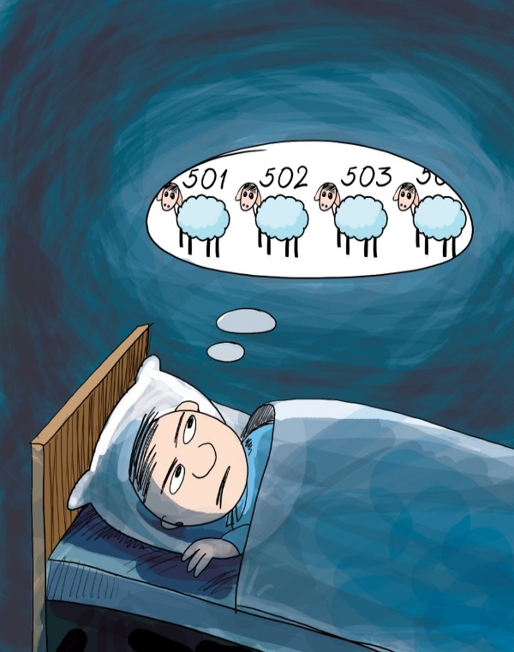
What’s keeping us up at night?
Today’s healthcare environment is highly complex AND marked by competing values systems and agendas:
  Regulation vs. Innovation
  Market justice vs. Social justice
  The Triple Aim vs. the “Policy trilemma”
  Management of Chronicity vs. Cost of Care Reduction
  Individualized Care vs. Population Health Management

Slide 8
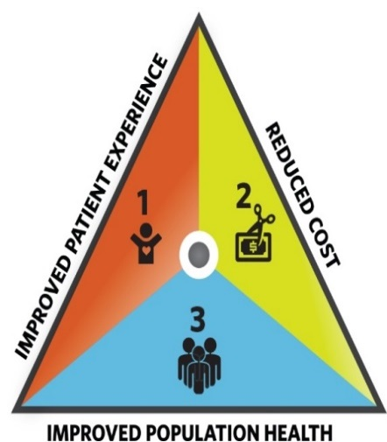
Triple Aim vs. Policy Trilemma
Health
Equity
Wealth
In an arena historically dominated by economic and financial “trade-offs” it is philosophically and technically difficult to excel alone in all 3 components of the Triple Aim (Bhattacharya et al, 2014).

Slide 9
Complex Populations Coupled with a Fragmented Care System
We are collectively servicing populations that are marked by:
  Acuity
  Chronicity
  Advanced Age
  Health Disparities
  Premature Disability
  Resource Deficiencies
National health expenditures will hit $3.35 trillion this year, which works out to $10,345 for every man, woman and child
(Alonso-Zaldivar, R. 2016).
U.S. health care spending is wildly uneven. About 5 percent of the population — those most frail or ill — accounts for nearly half the spending in a given year
(Alonso-Zaldivar, R. 2016).
Add to all of this that we have multiple providers, payers, healthcare systems, post acute partners, specialties and strategies on how to support our collective patients.

Slide 10
The Cost of Complexity
When you crunch the cost-related macro numbers, it makes sense that policies and penalties would aim to:
  Emphasize quality
  Improve mortality rates
  Highlight patient experience
  Drive down readmission rates
  Underscore data collection and analysis
Overall, we have to find a way to decrease the total cost of care without decreasing the total quality of our care.
What is missing is a roadmap that cuts through the complexity and
a better way to bridge the inpatient and outpatient worlds.

Slide 11
Care Coordination/ Transitions in Care
The paradox becomes that even we have a myriad of great initiatives they can and do translate to a series of competing agendas when we do not have a common strategy and language to unify our work.
Behavioral Health –
Tele-Psych
Community Initiatives
Palliative Care
Disease Management Programs
Community Care Coordination
Re-admissions Initiative (NW, and Sinai)
The SNF Collaborative
Population Health Management
Reducing PAU’s
Big Data increasingly has the potential to enhance overall corporate strategy and to service as a common language for corporate initiatives

Slide 12

Andrew McAfee once said, “The world is one big data problem.”
I would add that the world becomes a bigger data problem when you don’t know where to start.

Slide 13
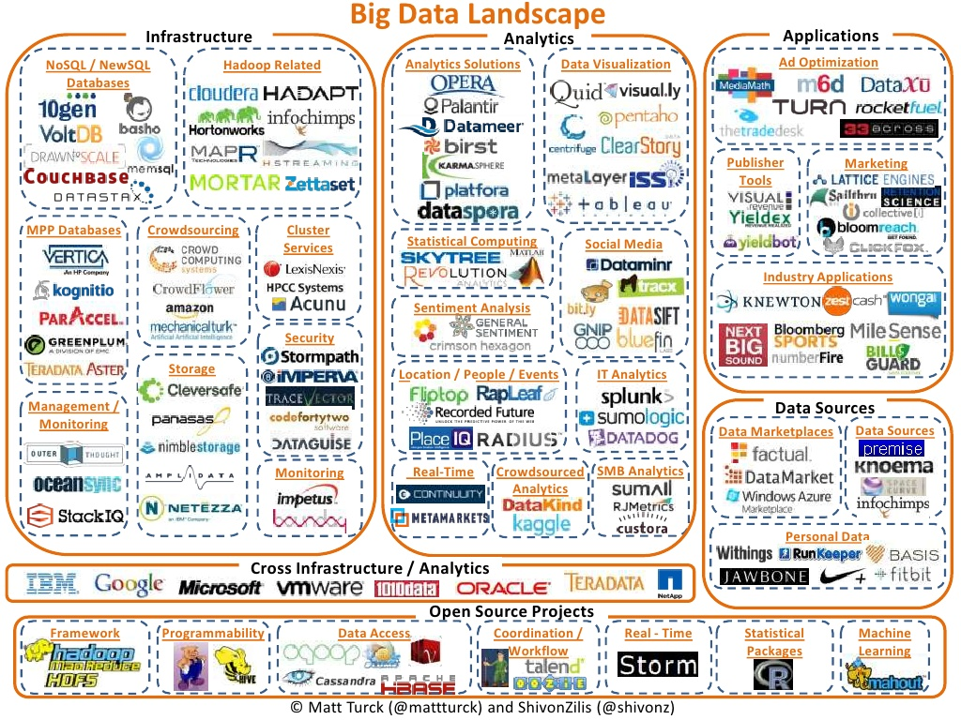

Slide 14













Many Data Sources & Many available tools :
Data Aggregation/Integration is a Necessity
Data Sources
Extract, Transform, & Load
Integration, Mapping, & Standardizing
Visualization
Delivery
Analysis
Data sources continue to grow and capture information
People are a primary tool
Visualization of the data
Data distribution/ delivery
Multiple Tools most still basic
Multiple Integration engine(s) and staff
Cerner
Data analysts
Several Databases for aggregation (vendor/internal)
Database/System integration tools/systems which can also be considered data sources/domains:
  HSCRC
  CRISP
  St. Paul
  Perahealth
  Point Right
  Premier
  Midas
Lawson
HPM
Paragon
HBI
Centricity
HCS
Vlookups
Excel macros
CareFirst
SFTP
DBMS
Press Ganey
Portals
CRISP

Slide 15
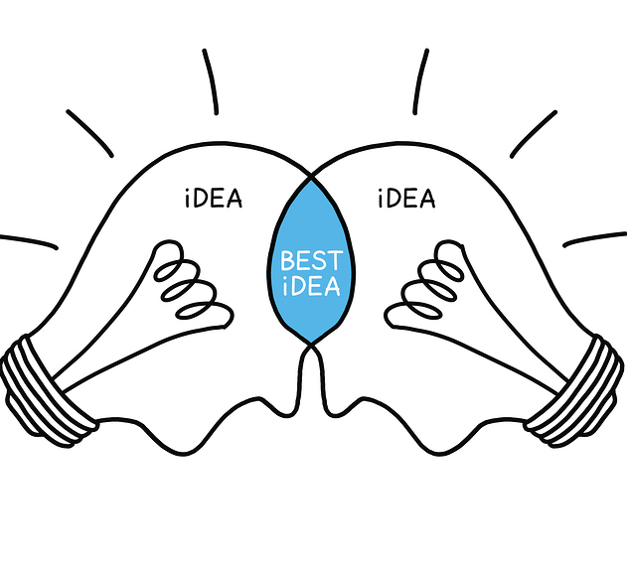
The LifeBridge Preferred Provider Network (PPN)
We developed our Preferred Provider Network (PPN)
in order to further:
  Construct our care continuum
  Identify process strengths and vulnerabilities
  Link data and analytics to process improvement
  Capitalize off of resource sharing
  Collaborate across our corporate system
  Emphasize that no one provider can or should “do it all”

Slide 16
Overcoming Barriers to Data Access
The Problem: Administering a continuum of care with little to no data
Depending on the hospital site, on average 14%-24% of our patients high risk and chronically ill patients are transitioned to NHs. We are able to track data within our hospital environment, however collecting data from our NH/SNF providers presented a problem.
Prior Care Setting
Hospital
Post Acute
Then What?
Yet a PAC can play a big role in what happens next

Slide 17

About the Preferred Provider Network
Currently encompasses 36 active providers (free-standing, chain, and hospital-based providers) of which have live active data feeds
The Collaborative tracks key metrics:
  Rehospitalization Rates
  LOS in facilities
  Staffing matrices
  Key quality domains
  Regulatory compliance
  Performance with top 5 DRGs
  Patient and family experience
Facility performance is continuously compared to the State and National averages.

Slide 18
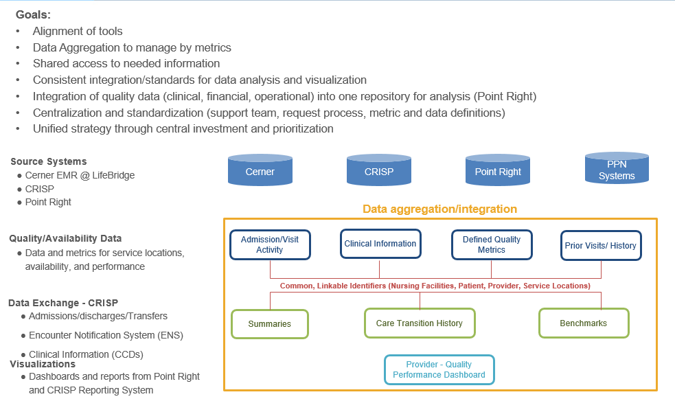
Target Data Integration and Aggregation to support a Preferred Provider Network

Slide 19
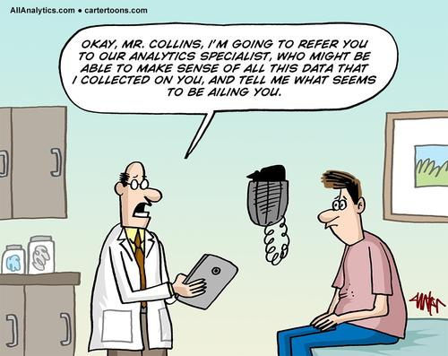
Data collection is one thing but using it to generate value can be quite another …

Slide 20
Network Performance Management
16.5 | PointRight Pro30 Adjusted MD Average
17.1 | PointRight Pro30 Adjusted National Average
355 | QM MD Average
352 | QM National Average
8.1 | Overall Rating of Care MD Average
16.5

Slide 21
Network Performance Management
 | Benchmark | LBH - All Payer | LBH - Pro30 Medicare
PointRight Pro30 Adjusted MD Average | 16.5 | 16.8 | 16.7
PointRight Pro30 Adjusted National Average | 17.1 | 16.8 | 16.7
 | Benchmark | LBH - All Payer
QM MD Average | 355 | 390
QM National Average | 352 | 390
Overall Rating of Care MD Average | 8.1 | 8.1

Slide 22
Network Performance Review
Groups Averages for DRGs
DRG | LBH Average RH Rate | MD RH Rate | National RH Rate
CHF | 17.2 | 16.5 | 17.1
COPD | 17 | 16.5 | 17.1
CVA | 15.4 | 16.5 | 17.1
DM | 17.2 | 16.5 | 17.1
PNA | 16.8 | 16.5 | 17.1
Recent Surgery | 16.7 | 16.5 | 17.1
The values highlighted in red are he DRGs that the networked failed to meet both the State and National Benchmarks

Slide 23
What are the critical elements to driving real results?
So how do you get here?

Slide 24
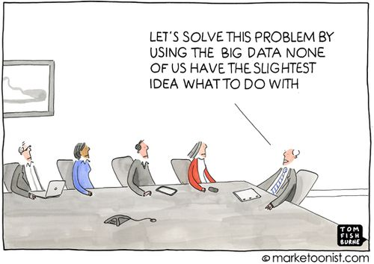
Using Data as your Common Language
While data collection and analysis have become necessary components to legitimize the work done by healthcare entities, healthcare entities continue to have a tenuous regard and relationship with data. Data is
often paired with:
  Anxiety
  Skepticism
  Frustration
  Missed opportunities
  Sanctions and Penalties
Embracing data as a success enabler requires the recognition of these associations. When the quality of the data goes up, the group is more likely to adopt it as a “common language”.

Slide 25
Analytics to Support PAU’s
Multiple Teams/Activities involved
Go forward Direction
Population Health Team
Local Teams
Facility Activities
Care Management Team
Finance Focus
HSCRC/CRISP Analytics
HPM
Premier Analytics
Community Partnerships
Establish focused team
Review and confirm data sources and definitions
  AHRQ
  HSCRC
Agreed and approve dashboard/scorecard

Slide 26
Organizational Alignment on Data Governance

Slide 27
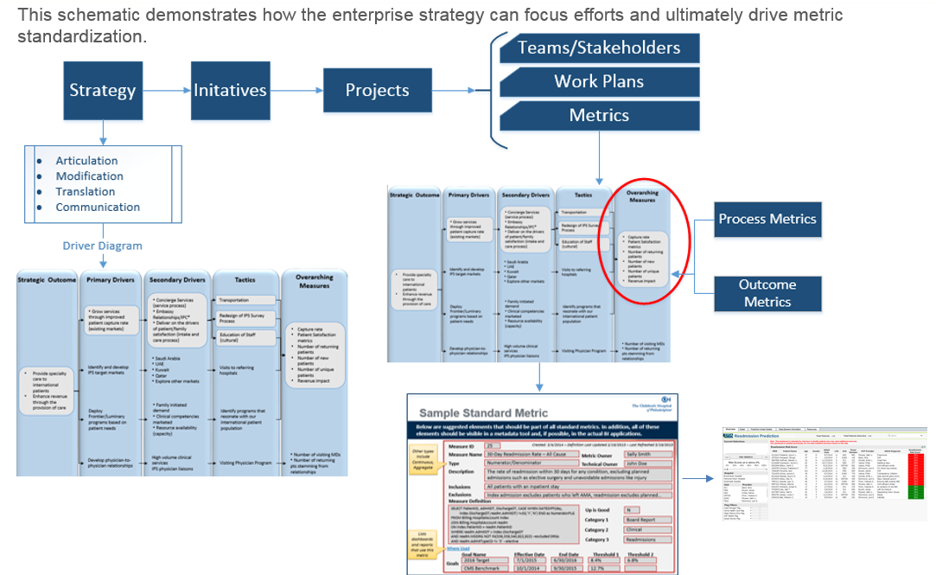
Making PAU’s - Direct Line of Sight & Alignment of Performance Metrics
Polarities
Culture (Strong Goals & Accountability)
Burning Platform (Carrot)
Guiding Principles
Formalized Approach
Focus

Slide 28
So let’s return to the question of how do you produce results?

Slide 29
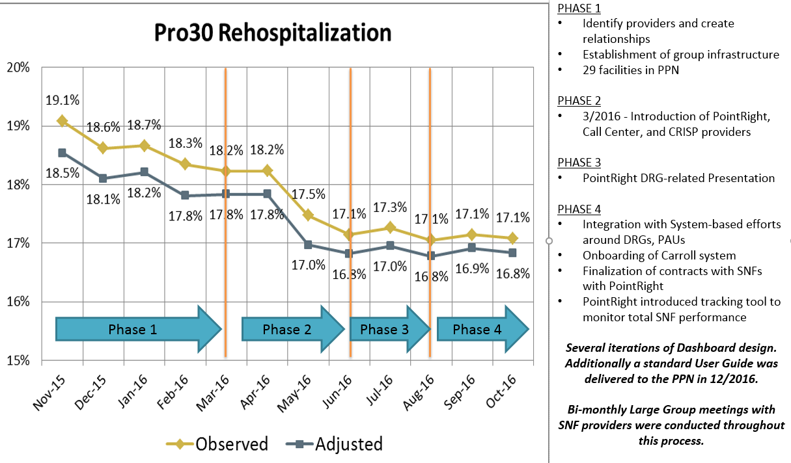
Preferred Provider Network Development Timeline

Slide 30
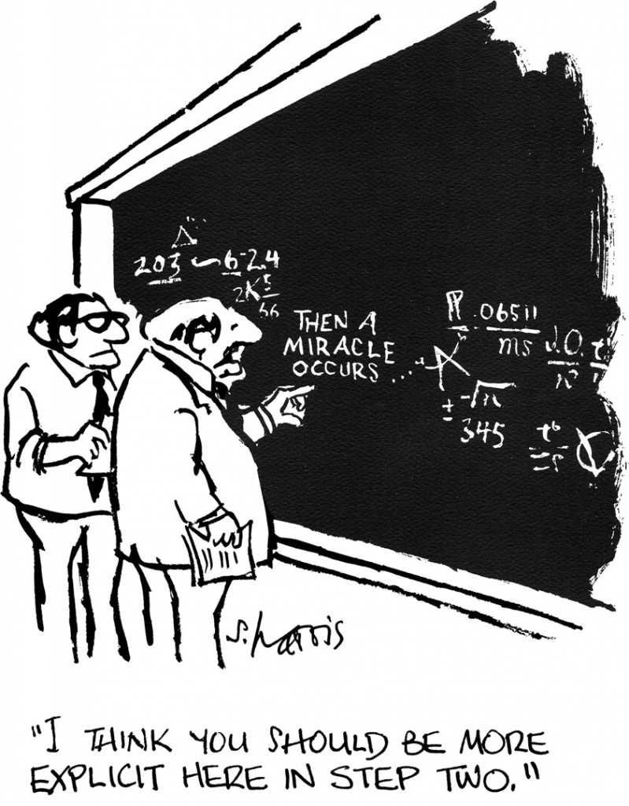
Don’t forget the value of relationships
Data collection and production alone does not solve all of your problems. You have to be equally good at building relationships and integrating it with your organization’s strategic plan.

Slide 31

Strategies for Data Application
Key strategies for successfully leveraging data and analytics:
  Collect more data rather than less data and automate whenever possible
    Collect 12 months worth of data before setting performance benchmarks - History
  Collect and organize data that SNFs will already need for reporting
    Their success will result in your success - Alignment
  Align your data collection with your high-impact organizational goals and programs – Governance - Manage the right Metrics
    PAUs, Palliative care, Disease Management, Med Management, Care Coordination
  Simultaneously assess for resource gaps while tracking PPN performance
    When possible share resources, education, and expertise - Collaborate
  Do not generalize data unless you understand your SNF partners
    Drill past the false conclusions that can result from aggregate data – when data is not perfect, use it directionally - Define
  Integrate your work with the entire Care Team and Community with an agreed upon common focus for quality and outcomes - Integrate
Know your communities, your providers and the care teams.

Slide 32

Moving Forward with Preferred Provider Network
We began this conversation by acknowledging that we inhabit a healthcare landscape populated by change, complexity and lots of data.
Moving forward we will utilize our PPN initiative to:
Work to integrate our PPN initiative with the operational processes of Care Management teams
Stand up our new Community Care Coordination program
Continue to focus on improvement and smoothing of transitions of care
Further integrate with advanced use of clinical data

Slide 33

Preferred Provider Networks
Questions, concerns, and feedback are welcome

Slide 34

Bernie Galla, RN, BSN, MBA
bgalla@lifebridgehealth.org
Susan C. Westgate, MBA, MSW, LCSW-C
swestgat@lifebridgehealth.org

Slide 35
References
Alonso-Zaldivar, R. (2016). $10,345 per person: US health care spending reaches new peak. The Rundown. Retrieved from: http://www.pbs.org/newshour/rundown/new-peak-us-health-care-spending-10345-per-person
Bhattacharya et al (2014). Health Economics. New York, NY: Palgrave MacMillan

Slide 36


