Slide 1

Benefits of Early Referral to Palliative Care for the Chronically & Terminally Ill
Presented by: Kristina Marquez, Care Coordinator, Real Time Medical Systems

Slide 2


Goals for This Patient Population
Increase quality of life
Ensure care is aligned with patient wishes
Decrease prevalence of futile treatments
Reduce overall healthcare costs

Slide 3
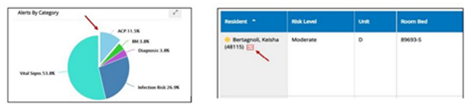
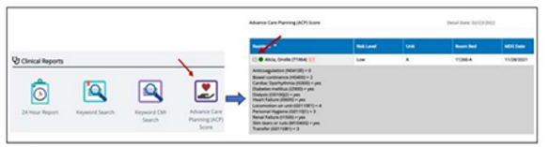
ACP Score
ACP
Based off the Personal Severity Index
    Score >9 means high risk of mortality in the next year
    Pulled from MDS
Enables providers to set families’ and residents’ expectations and avert the emotional decision making that often leads to inappropriate or unwanted care.

Slide 4
The World Health Organization has defined Palliative Care as:
“An approach that improves the quality of life of patients and their families facing the problems associated with life-threatening illnesses through the prevention and relief of suffering by means of early identification and impeccable assessment and treatment of pain and other problems.”
- Comprehensive and holistic
- Treating physical, spiritual, and psychosocial needs of the patient

Slide 5
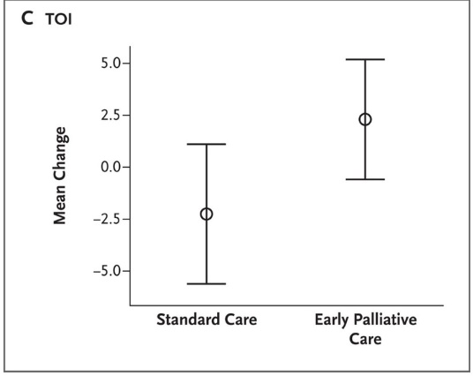
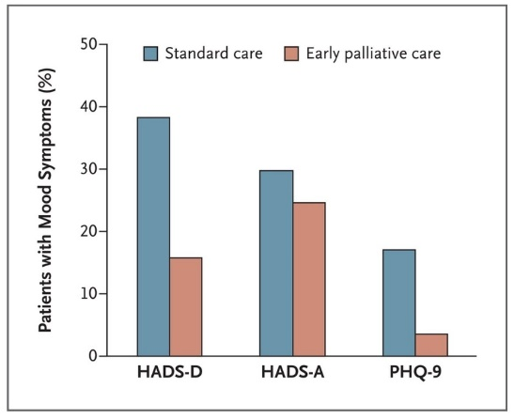
Goal #1: Quality of Life
Research published by the NEJM studied 151 patients with dx of metastatic non-small cell lung cancer. The research concluded that early palliative care led to significant improvements in both quality of life and mood.
Mean change in QOL scores from baseline to 12 weeks in the two study groups
Twelve-week outcomes of assessments of moods

Slide 6
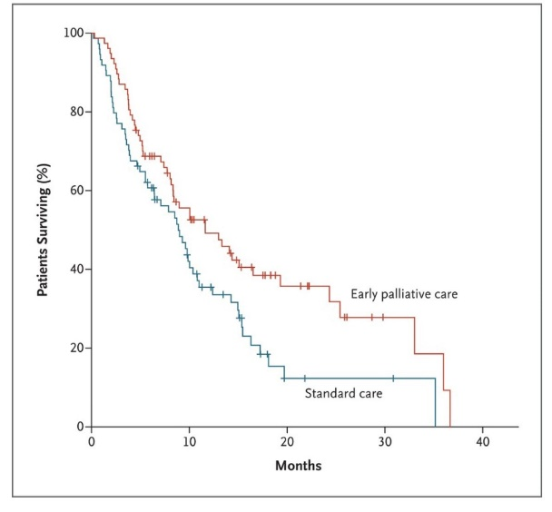
Goal #1: Quality of Life Cont’d
Median survival was longer among patients receiving early palliative/hospice care. 11.6 vs. 8.9 months.
Why?
Patients received care that resulted in better management of symptoms, leading to stabilization of their condition, and prolonged survival.

Slide 7
Goal #2: Care Aligned with Patient Wishes
Many studies have shown that people, when asked, say they’d prefer to die at home rather than in a hospital. However, these wishes aren’t always realized if a person hasn’t been given clear instruction to a doctor or family member.

Slide 8
Having a Thoughtful MOLST Discussion
Review what is known about the patient's goals and values.
Understand and provide the medical facts about the patient’s current medical condition and prognosis.
Find un-interrupted time for discussion.
Provide information in small amounts, giving plenty of time for a response.
Be sure to re-visit the MOLST discussion with any new change in condition.
Remind your patient or health care proxy that a MOLST form can be changed at any time.

Slide 9
Goal #3: Decreased Futile Treatment
What is considered futile?
“Care that neither produces a demonstrable positive effect, nor changes the prognosis, nor improves the patient’s quality of life.”
Why is futile treatment so common?
Fragmented care
Patient and/or family are not fully informed of risk vs. benefit of medical interventions

Slide 10
Case Example
72 y/o SNF cachectic female with history of Alzheimer's has significant decline in functional status. Bed bound, minimally verbal, nectar-thick diet / hx of aspiration PNA
  Has now lost interest in eating, continues to lose weight, and has developed a stage 2 sacral decubitus.
  Foley is placed to prevent further breakdown.
  The patient’s husband now requests a feeding tube be placed so his wife doesn’t “die of PNA or starve to death”.
  Feeding tube is placed without full discussion regarding the risk vs benefit of tube feeding.
  Patient develops chronic UTI’s and has now developed C-diff due to on-going antibiotic treatment.
  Due to bloating and diarrhea tube feed is discontinued several times.
  Patient’s BP drops due to dehydration.
  Patients develops a fever and tachycardia. A chest x-ray reveals bilateral infiltrates.
  Patient is sent to E.R for further evaluation.

Slide 11
What the Patient and Family Didn’t Know
There is no decrease in risk of aspiration PNA with placement of a feeding tube. Aspiration PNA occurs in up to 50% of patients with feeding tubes.
There is no evidence enteric nutrition by feeding tube improves nutritional markers or decreased risk for pressure ulcer formation or improves healing of ulcers in a demented patient.
PEG tube placement is associated with significant morbidity and mortality.
Pain, abdominal ulcers, wound infections peristomal leakage, and tube displacement occur in approximately 10% of cases.

Slide 12
Results
Locks chronically ill patients, most of who are elderly, into a test-and-treat cycle of hospitalization, convalescence and deterioration even as it’s clear the end is near, and the cycle is only making their final days severely uncomfortable.

Slide 13
Goal #4: Healthcare Cost Reduction
In 2017, The Institute of Medicine estimated $750 billion dollars was spent in unnecessary medical treatments.
30-50% of medical treatments are low value, they either do not help people or they harm them.
A study of 13,000 doctors found that only 10% of them accurately assessed risks and benefits of interventions, typically exaggerating the latter.
A similar study revealed that when patients used decision aids to assess orthopedic surgical treatments rather than simply listening to doctor advice, they typically chose less invasive options and saved over $1,000 a year for all patients in the system.

Slide 14
Palliative or Hospice?
Both focus on comfort and holistic care, but what is the difference?
Palliative care: Can begin at diagnosis, and the same time as treatment. Focuses on relieving symptoms of serious illness or disorder – dependent on the diagnosis. Appropriate at any stage of illness. Physician referral required.
Hospice: Comfort care without curative intent. Physician must make a clinical determination that life expectancy is six months or less if the illness has run its normal course. Focus is completely on comfort.

Slide 15
What do These Patient’s Look Like?
Cancer: Usually metastatic; prognosis is typically poor but may not have been discussed. Weight loss, nausea, pain, and weakness are common.
CHF: Poor response to diuretics and vasodilators; dyspnea at rest; impaired heart rhythms; ejection fraction < or = 20%; oxygen dependent.
COPD: Frequent exacerbations and hospitalizations; decreased FVC (<than 40%); decreased FEV (<than 30%); dyspnea at rest; oxygen dependent.
ESRD: Patient does not want dialysis or chosen not to continue; uremia; hyperkalemia; fluid overload.
Stroke and Coma: PPS <40%; weight loss; decreased albumin; history of dysphagia and aspiration.

Slide 16
Medicare Coverage for Palliative Care
Medicare beneficiaries who choose palliative care are covered under Original Medicare or Medicare Advantage.
Refer to the following website for detailed information on Medicare coverage and eligibility:
https://www.healthline.com/health/medicare/does-medicare-cover-palliative-care#how-it-works

Slide 17

Questions? Let’s Discuss!
Real Time Medical Systems is the industry-leading, KLAS Rated Interventional Analytics solution that
turns post-acute EHR data into actionable insights.
Serving healthcare organizations nationwide, Real Time improves clinical and financial outcomes by
reducing hospital admissions, accurately managing reimbursements, detecting early signs of infectious disease, automating antibiotic surveillance, and advancing care coordination through post-acute data transparency. www.realtimemed.com

Slide 18
References
Kodjak A. (2016, June 15). Dying in a hospital means more procedures, tests, and costs. NPR.org. https://www.npr.org/sections/health-shots/2016/06/15/481992191/dying-in-a-hospital-means-more-procedures-tests-and-costs
Rifkin E, Lazris, A. (2017, August 16). Gauging the real risks and benefits of a medical procedure. The Baltimore Sun. https://www.baltimoresun.com/opinion/op-ed/bs-ed-op-818-wasteful-spending-health-20170816-story.html
Saraswathi D.P. (2011). A Timely Referral to Palliative Care Team Improves Quality of Life. ncbi.nlm.nih.gov. https://www.ncbi.nlm.nih.gov/pmc/articles/PMC3140091/
Temel JS., Greer JA., Muzikansky A., Gallagher E. (2010 August 19). Early Palliative Care for Patients with Non-Small-Cell Lung Cancer. nejm.org. https://www.nejm.org/doi/full/10.1056/NEJMoa1000678

