Slide 1
Maryland Situation Update on
Coronavirus Disease 2019 (COVID-19) for Long Term Care
Maryland Department of Health
Infectious Disease Epidemiology and Outbreak Response Bureau
February 18, 2020
Notes:
Good afternoon and thank you all for taking the time to join us on this call today. My name is Heather Saunders and I am the nursing program consultant for the Office of Healthcare Associated Infections and Antimicrobial Resistance within the Infectious Disease Epidemiology and Outbreak Response Bureau. I am here today accompanied by numerous colleagues at the Maryland Department of Health to discuss the current situation and response to the Coronavirus Disease 2019 or COVID-19 first identified in Wuhan City, Hubei Province, China. This call is specifically for long term care facilities. If you are a member of the media we kindly ask that you disconnect at this time. During the presentation we ask that you keep your phone on mute. You are welcome to post questions in the chat box as we progress through the slides. We will begin to answer questions at the end of the presentation.

Slide 2
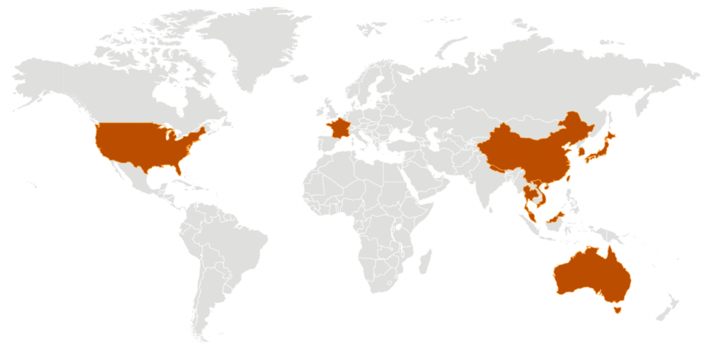
Call Agenda
Review current situation of COVID-19
Discuss long term care facility preparedness
Discuss shortages in personal protective equipment
Notes:
On today’s call we will briefly review the current situation of COVID-19, discuss how long term care facilities can improve their prevention of respiratory viruses such as the COVID-19 causative SARS-CoV-2 virus, and discuss the emerging shortages in the access to personal protective equipment.

Slide 3
What is a coronavirus?
Family of enveloped viruses that infect humans and animals
40 species of coronavirus
Typically cause respiratory infections with mild to severe symptoms
Some coronaviruses originate in animals
SARS-CoV-2 - new coronavirus that causes COVID-19
Notes:
Before we begin to discuss the outbreak, I want to provide a brief overview of coronaviruses in general. Coronaviruses come from a family of enveloped viruses called the Coronaviridae, some of which can infect humans and animals. There are over 40 species of coronavirus and of those that infect humans, they typically produce respiratory symptoms that vary from mild to severe. Some coronaviruses are called human coronaviruses as they have the natural capability of infecting humans. Other coronaviruses have originated in various animals but occasionally these viruses will jump species and develop the ability to infect humans. This was the case with the current MERS-CoV virus, the 2003 SARS coronavirus, and the recently emerged SARS-CoV-2 coronavirus, identified in 2019 that causes the respiratory disease being referred to as COVID-19.

Slide 4
Current Situation
What – >70,000 infections and approximately 1,700 deaths.
Where – Highest numbers in Hubei province followed by Mainland China.
Symptoms – Range from mild to severe; Fever, cough, sore throat, and difficulty breathing
Transmission - Person-to-Person transmission is occurring
Severity – Mild to severe illness
Notes:
COVID-19 was identified on December 31, 2019 when an outbreak of pneumonia of unknown etiology in Wuhan City was reported to the WHO. Current reports state that over 70,000 infections have now been reported with just over 1700 deaths. The majority of these infections have been identified in the Hubei province followed by mainland China. COVID-19 infections are also being reported in a growing number of countries internationally, including in the United States, where 15 infections with COVID-19 have now been confirmed. More cases are likely to be identified in the coming days, including more cases in the United States. There are a limited number of reports that describe the clinical presentation of patients with confirmed COVID-19, and most are limited to those hospitalized patients with pneumonia. Frequently reported signs and symptoms have included fever, cough, fatigue, sore throat, and shortness of breath. CDC believes at this time that symptoms of COVID-19 may appear in as few as 2 days or as long as 14 days after exposure. This is based on what has been previously seen as the incubation period of other coronaviruses. Initially, identified patients had epidemiological links to a large seafood and animal market in Wuhan City, suggesting animal-to-person transmission. However, since then, it has become certain that person-to-person spread of 2019-nCoV is occurring. Current estimates suggest that each infected case is infecting 1.5-3.5 other persons although it is too early to say this for certain. It is unknown just how many infections progress to severe illness, as both mild to severe illnesses have both been observed.

Slide 5

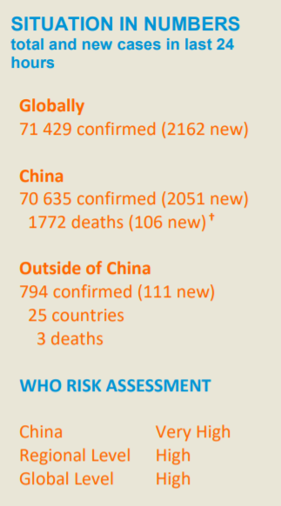
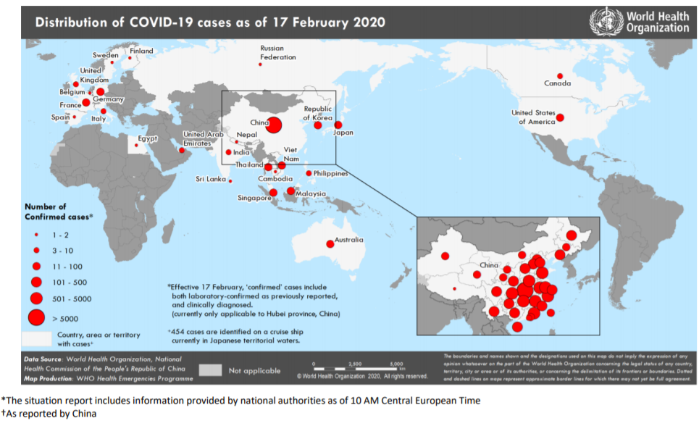
Confirmed COVID-19 cases in China, Hong Kong, Macau, Taiwan, Australia, Belgium, Cambodia, Canada, Egypt, Finland, France, Germany, India, Italy, Japan, Malaysia, Nepal, Philippians, Russia, Sri Lanka, Singapore, Spain, Sweden, Thailand, The Republic of Korea, UAE, United Kingdom, United States, Vietnam
Source: https://www.who.int/docs/default-source/coronaviruse/situation-reports/20200217-sitrep-28-covid-19.pdf?sfvrsn=a19cf2ad_2, accessed February 17, 2020
Notes:
As of February 17th, 25 countries outside of China have identified cases of COVID-19. Countries that have identified cases include….. As we have said before, this continues to be a rapidly evolving outbreak that is literally emerging in front of our eyes. It is likely that additional cases will be identified in other countries in the coming days and weeks.

Slide 6
U.S.: COVID-19 Cases and PUI
15 confirmed cases in 7 states
  Washington State, Illinois, California, Arizona, Massachusetts, Wisconsin, and Texas
60 Persons Under Investigation (PUI) in 42 states
  15 positive, 392 negative, 60 pending
Evidence of person-to-person spread in the US and other countries
Source: www.cdc.gov, accessed February 14, 2020
Notes:
As of February 17, In the United States, case count is currently at 15 in 7 different states, including Washington state, Illinois, California, Arizona, Massachusetts, Wisconsin, and Texas.
60 Persons are currently under investigation in 42 states with 15 positive and 392 negative.
As mentioned in a previous slide, several of these cases have now been directly linked to other cases in the US by close contacts, providing further evidence of person-to-person spread.

Slide 7
Maryland: COVID-19 Cases and PUI
Number of persons tested: 2
Number of COVID-19 tests pending: 0
Number of negative COVID-19 tests: 2
Number of laboratory-confirmed cases: 0
Testing and case counts posted at http://health.maryland.gov/coronavirus
For information about specimen collection please visit
https://health.maryland.gov/laboratories/Pages/Novel-Coronavirus.aspx
Data current as of February 18, 2020
Notes:
As of today, Maryland has tested 2 individuals for novel coronavirus. Both tests have been confirmed negative by CDC’s laboratory. No tests are pending. We will continue to provide updates on the testing and case counts on our website at health.Maryland.gov/coronavirus.

Slide 8
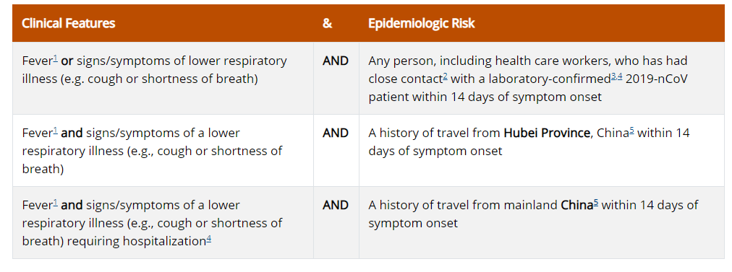
Patient Identification
Notes:
In order to assist in the identification and testing of patients suspected of COVID-19, CDC has developed testing criteria or what we refer to as criteria for persons-under-investigation for COVID-19. Patients in the United States who meet these following criteria should be evaluated as a PUI for COVID-19. Reading from the first row, persons must have fever OR signs and symptoms of lower respiratory illness, and have had close contact with a laboratory confirmed COVID-19 patient within 14 days of symptom onset. Reading from the second row, persons should be evaluated as a PUI for COVID-19 if they’ve had fever AND symptoms of lower respiratory illness with a history of travel from the Hubei Province, China within 14 days of symptom onset. Then finally reading from the 3rd row, persons should be evaluated as a PUI for COVID-19 if they’ve had Fever AND signs/symptoms of a lower respiratory illness that requires hospitalization AND a history of travel from mainland china within the past 14 days of symptom onset. It is again important to note that fever may not be present in some patients, such as those who are very young, elderly, immunosuppressed, or taking certain fever-lowering medications. Additionally, self-reports of fever from patients do count as meeting the definition in the absence of fever documentation in the clinical setting.

Slide 9
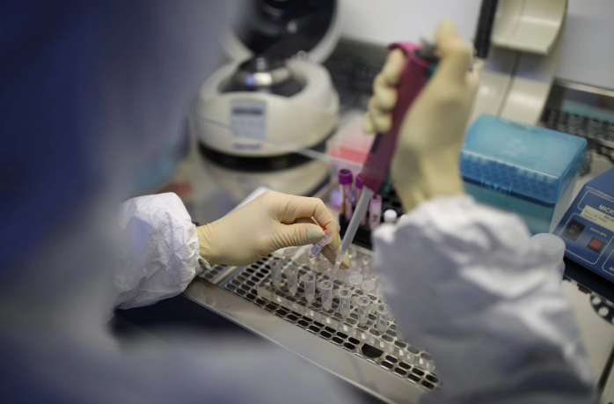
SARS-CoV-2 Testing
Testing only performed at CDC.
Upper and lower respiratory specimens run on RT-PCR
Rapid viral panels CANNOT detect SARS-CoV-2
Notes:
Currently, testing for COVID-19 is only being performed at CDC’s laboratory. Maryland’s public health laboratory continues to work on the validation of this test so that testing will be locally available. For testing, upper and lower respiratory specimens are collected and run on reverse transcriptase PCR. It is important to note that rapid viral panels cannot detect the SARS-CoV-2 virus. Therefore, when rapid viral panels identify coronavirus, it is identifying one of the other species of coronavirus and not SARS-CoV-2.

Slide 10
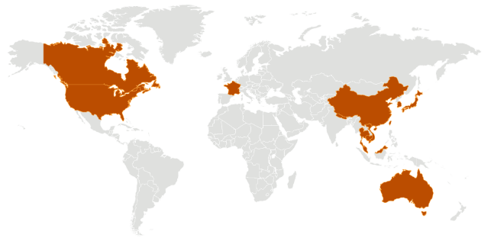
Recommendations for travelers returning from China
Stay home for 14 days after departure from China
Asymptomatic individuals
  Remain at home.
  Avoid congregate settings.
  Limit public activities.
  Practice social distancing.
  Postpone additional travel
https://www.cdc.gov/coronavirus/2019-ncov/php/risk-assessment.html
Notes:
Due to the increased risk of transmission in various parts of China, CDC has developed guidance for the monitoring and self-isolation of travelers returning from various parts of China since February 5th. This guidance is specifically for US public health authorities and partners to provide a framework for assessing and managing the risk of potential exposures to COVID-19 while implementing public health actions based on that person’s risk level and clinical presentation. Some of these actions may include active monitoring or public health supervision of self-monitoring and the application of movement restrictions, including staying home for 14 days post after departure from China, and quarantine, if needed. These asymptomatic travelers should remain home to the extent possible, avoid congregate settings, limit public activities, practice social distancing, and postpone additional travel. Again, this is due to the increased risk for travelers returning from China. We are not making any formal recommendations for this guidance to be retrospectively applied before the date of February 5th. Any individuals returning from China, including any employees of your facilities should follow this guidance, self-monitor for symptoms, and contact by phone their local health department and provider if they develop a fever or cough or difficulty breathing during this 14-day period. Symptomatic individuals will then be evaluated by public health to determine their need for testing. We encourage facilities to work out ways that they can allow their employees to remain home while still receiving their full pay and being able to return to their jobs at the end of their 14 day isolation period. CDC has also provided additional guidance for employees exposed to COVID-19 in the healthcare setting in the event that we begin to see cases in Maryland.

Slide 11
Preventing Respiratory Viruses in LTC
Daily monitoring and recording of fever and respiratory illness in residents and staff.
Staff should remain home until 24 hours fever free and wear a mask if exhibiting any signs of respiratory illness (e.g. sore throat, cough, runny nose, etc).
Ensure non-punitive, flexible sick leave policies to prevent ill employees from working.
Encourage influenza vaccination in staff and residents.
Promote respiratory hygiene and cough etiquette.
Notes:
So now I want to switch over to discussing preparedness for long term care facilities. How can we best prepare our facilities in the event that we start to have cases or community transmission of COVID-19? Well in a lot of ways, our preparedness for preventing cases of COVID-19 in long term care is very similar to what we currently do to prevent the transmission of other respiratory viruses. I want to talk for a moment about 10 concrete steps that we would like every long term care facility to take to ensure the protection of our residents and healthcare workers from COVID-19 and other circulating respiratory viruses. Every facility should already be performing daily surveillance for respiratory viruses, training their staff to look for signs and symptoms of respiratory illness in residents, placing them immediately on droplet precautions, and reporting symptoms to their infection preventionists. Infection preventionists should be keeping a separate line listing of respiratory illness for residents and staff members in order to quickly identify outbreaks of respiratory illness in facilities. This is the time to review sick policies with your employees. All staff should remain home until 24 hours fever free and staff with respiratory symptoms should wear a mask if exhibiting signs of illness such as sore throat, cough, or runny nose. It is still not too late to receive a flu vaccination and we should encourage our staff and residents to receive a vaccination if they have not already. The flu is still widespread in Maryland and at high intensity. You can help dispel vaccination myths through education and ensure high vaccination rates in your facilities. Sometimes prevention is easy but for everyone it’s not always intuitive or common sense. So continue to promote good respiratory hygiene and cough etiquette through education of staff and residents. Send out flyers, create some creative, engaging education, and post signs in the facility.

Slide 12
Preventing Respiratory Viruses cont…
6. Encourage frequent hand hygiene.
7. Screen visitors for signs/symptoms of illness. Ensure compliance with policies that restrict sick visitors.
8. Maintain good environmental cleaning that focuses on daily disinfection of high touch surfaces.
9. Use standard and droplet precautions for residents showing signs/symptoms of respiratory illness.
10. Report outbreaks of respiratory illness to your local health department.
Notes:
Encourage good, frequent hand hygiene of staff and residents. Ensure staff recognize the value of alcohol based hand rub and ensure your facilities have dispensers that are easily available to staff at multiple points of access throughout the facility. Outside the door and inside the room is the best way to ensure staff can always access gel for hand hygiene.
Don’t let visitors in your facility that are showing signs and symptoms of respiratory illness. Screen visitors at the entrance of facilities and discourage them from visiting if they’re showing signs and symptoms of respiratory illness. Develop policies for your facilities that restrict symptomatic visitors from visiting residents. The front desk should be trained to say “Mr. Brown do you have any signs and symptoms of respiratory illness today? I’m sorry Mr. Brown, but we strongly discourage visiting with those symptoms so that we can continue to protect our residents from respiratory viruses.” If visitors must visit when ill during extenuating circumstances, they should be educated on the importance of wearing a mask for their visit. Now is the time to review your environmental cleaning and ensure that you are maintaining good environmental cleaning that focuses on the daily disinfection of high touch surfaces in the facility. Infection preventionists should be working closely with their environmental cleaning specialists to ensure that they understand their role in the prevention of respiratory illness at the facility. Standard and droplet precautions should be implemented at the first sign or symptoms of respiratory illness. Ensure front-line staff members have the autonomy to immediately implement precautions and know who to report symptoms to. And finally, know that we are here to help. The MDH guidelines for respiratory illness are available on our website and are posted at the end of this presentation. Outbreaks of respiratory illness should immediately be reported to your local health department.

Slide 13
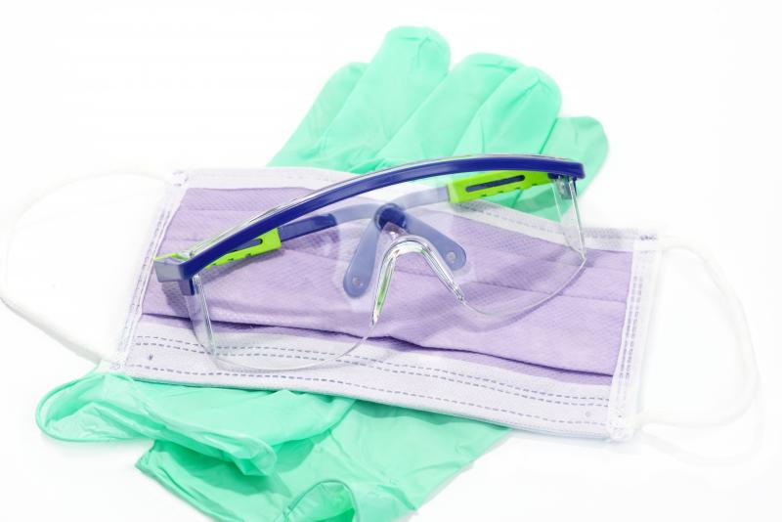
Personal Protective Equipment shortages
https://www.cdc.gov/coronavirus/2019-ncov/hcp/healthcare-supply-ppe.html
Decreased exports from select countries
Increases in demand for supplies
Manufacturers reporting challenges in meeting order demands
Reports of allocation for gowns and masks.
Per CDC, plans to surge manufacturing globally are underway.
Notes:
As we continue to monitor the COVID-19 situation in the United States and around the world, we prepare for the possibility that COVID-19 could become a more serious issue in the US, resulting in community transmission. We have recently become aware of shortages across the nation in the supply of personal protective equipment. Given decreases in exports from select countries such as China, India, and Taiwan and increases in the demand for supplies due to the outbreak, manufacturers of select types of PPE are reporting an increased volume of orders and challenges in meeting order demands. Due to the decrease in supply and increased demands, some distributors have reported to need to go on allocation in order to ensure that customers continue to receive product as it’s available. Per CDC, plans to surge manufacturing globally are underway. As a result, we want to discuss some steps that you should take when observing shortages of personal protective equipment in your facilities.

Slide 14
5 steps for PPE shortages in LTC
  Reach out to corporate and the manufacturer
  Don’t order/expect more PPE than what you need at this time of year
  Continue to appropriately isolate patients with flu and other respiratory viruses
  Protect against hoarding supplies and ensure staff appropriately utilize PPE
  Employ specific engineering and administrative controls such as limiting face-to-face contact with HCP.
https://www.cdc.gov/coronavirus/2019-ncov/hcp/respirator-supply-strategies.html
Notes:
In the event that your facility begins to experience shortages in the supply of personal protective equipment, we ask that you would follow the following 5 steps: First, reach out to your corporate office to report the shortage and contact your manufacturer for further information and advice. Secondly, do not order or expect more personal protective equipment than what you need at this time of year. Due to the shortages globally, facilities will not be able to increase their stock past what they would normally need. 3rd, Continue to appropriately isolate patients with the flu and other respiratory viruses immediately upon recognition of symptoms. 4th, protect against hoarding and the community use of face masks by educating your staff members on the appropriate use of personal protective equipment. CDC does not currently recommend that the general public be using facemasks. Instead, CDC recommends that the public follow everyday preventive actions, such as hand washing, covering your cough, and staying home when sick. There are no easy answers to the issue of personal protective equipment shortages. MDH continues to work on a coordinated and systemic response to this nation-wide problem but there are no simple fixes. Employers and healthcare personnel should be reminded that PPE is only one aspect of safe care for patients with transmissible diseases such as the flu or COVID-19. Visit the link on this slide to read more about the hierarchy of controls approach to preventing infectious disease transmission. Look to these for ways that your facility can conserve PPE during this current shortage. Administrative controls such as limiting-face-to-face HCP encounters and excluding HCP not directly involved in patient care of patients needing personal protective equipment can conserve PPE supply and reduce the risk of transmission of infectious diseases such as influenza.

Slide 15
Resources
CMS Memo on Coronavirus
MDH Novel Coronavirus: http://health.maryland.gov/coronavirus
MDH Laboratories Administration Novel Coronavirus:
https://health.maryland.gov/laboratories/Pages/Novel-Coronavirus.aspx
CDC Guidance for Healthcare Professionals https://www.cdc.gov/coronavirus/2019-nCoV/clinical-criteria.html
CDC Guidance for Infection Control https://www.cdc.gov/coronavirus/2019-nCoV/infection-control.html
Notes:
Take advantage of this list of resources to learn more about COVID-19. I also wanted to point out the recent memo from CMS calling ““Every Medicare participating facility in the Nation’s healthcare system to adhere to standards for infection prevention and control in order to provide safe, high quality care. As concerns arise with the emerging 2019 Novel Coronavirus (2019-nCoV) threat, CMS encourages all healthcare facilities to carefully review the information provided by the U.S. Centers for Disease Control and Prevention (CDC).
Because coronavirus infections can rapidly appear and spread, facilities must take steps to prepare, including reviewing their infection control policies and practices to prevent the spread of infection.“

Slide 16
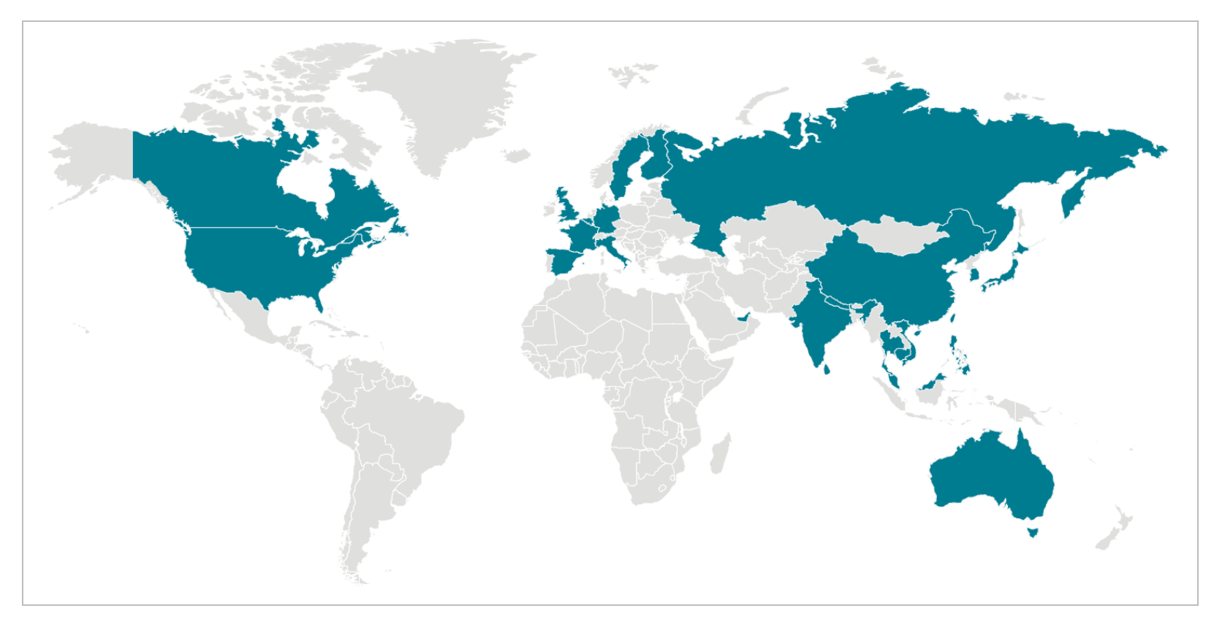
Questions?

