Slide 1
Maryland Situation Update on
Coronavirus disease (COVID-19) for Long Term Care
Maryland Department of Health
Infectious Disease Epidemiology and Outbreak Response Bureau
March 12, 2020
Notes:
Good afternoon and thank you all for taking the time to join us on this call today. My name is Heather Saunders and I am the nursing program consultant for the Office of Healthcare Associated Infections and Antimicrobial Resistance within the Infectious Disease Epidemiology and Outbreak Response Bureau. I am here today accompanied by numerous colleagues at the Maryland Department of Health to discuss the current situation and response to the Coronavirus disease 2019 or COVID-19 first identified in Wuhan City, Hubei Province, China. This call is specifically for long term care facilities. If you are a member of the public or the media we kindly ask that you disconnect at this time. During the presentation we ask that you keep your phone on mute. You are welcome to post questions in the chat box as we progress through the slides We will begin to answer questions at the end of the presentation.

Slide 2
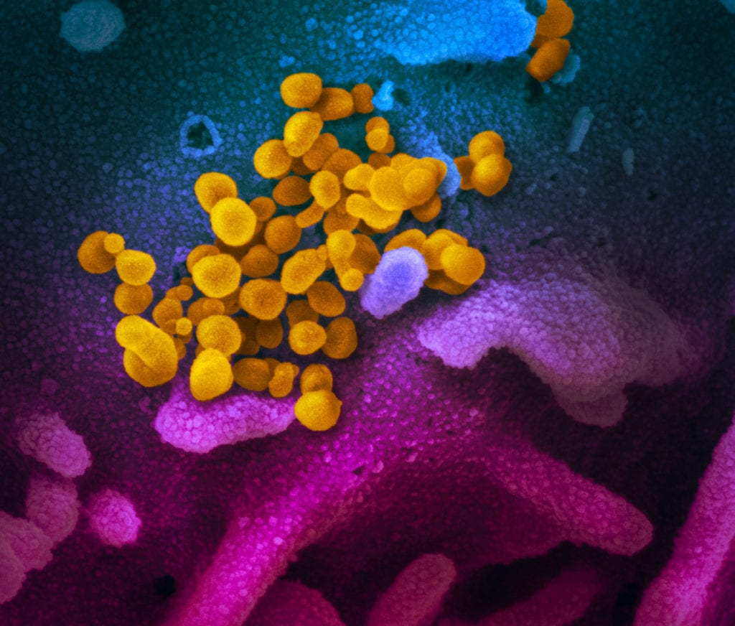
Call Agenda
Picture Courtesy of NIAID-RML
Review current situation of COVID-19
Concerns for LTC patient population
Preventing introduction of COVID-19
Potential Exposures
Caring for residents with COVID-19
Notes:
As usual, we have an incredibly packed agenda for today. On today’s call we will briefly review the current situation of COVID-19, discuss new PUI criteria, discuss ongoing efforts to improve testing capacity, discuss some hypothetical scenarios based on the new PUI criteria, hear from the Maryland Institute of Emergency Medical Services Systems, discuss recent hospital surveillance requirements for COVID-19, and further discuss guidance for PPE conservation and crisis alternate strategies.

Slide 3
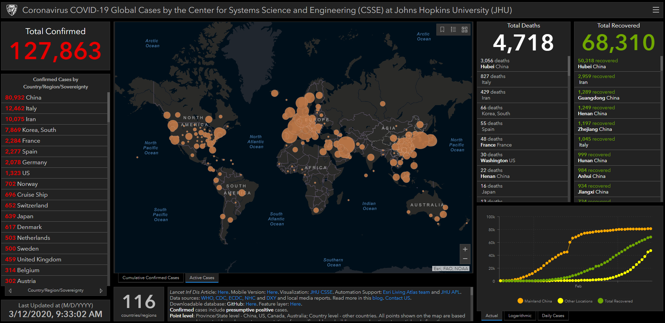
COVID-19 Situation Summary
Data current as of March 12, 2020
Notes:
A lot has happened since last weeks town hall. As of this morning, 127,863 infections have been reported with 4, 718 deaths. Over the past week, we’ve continued to see a rapid increase in cases being identified in other countries, including our own. Concerns are increasing globally for sustained community transmission and person to person spread. As of this morning, cases have now been identified in 116 countries.

Slide 4
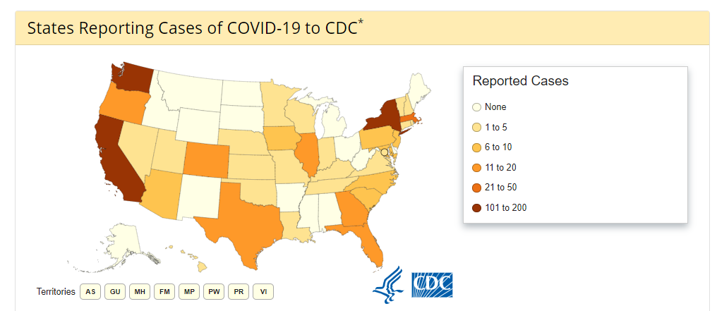
U.S.: COVID-19 Cases and PUI
COVID-19: Confirmed Cases in the US
  92 Travel-related cases
  75 Close contact
  771 “Under Investigation”
29 total deaths
39 states reporting (Including DC)
Source: www.cdc.gov, accessed March 10th
Notes:
There have undoubtedly been an explosion of cases in the United States over the last week… As of March 10th, of the confirmed cases in the United States, 83 have been travel-related cases, 36 have been from known person-to-person spread, and 528 cases are currently under investigation with no known current exposure.

Slide 5
Long-Term Care Residents are at Risk for
Serious Illness from COVID-19
Who is at higher risk
  Older adults
  People who have serious chronic medical conditions like:
    Heart disease
    Diabetes
    Lung disease
Notes:
Early information out of China, where COVID-19 first started, shows that some people are at higher risk of getting very sick from this illness. Individuals at a higher risk include older adults and people who have serious chronic medical conditions such as heart disease, diabetes, and lung disease. Individuals that are at higher risk for serious illness from COVID-19 because of their age or because they have a serious long-term health problem should take specific actions to reduce their risk of getting sick with the disease. Essentially all the residents in our facilities are at higher risk for COVID-19

Slide 6
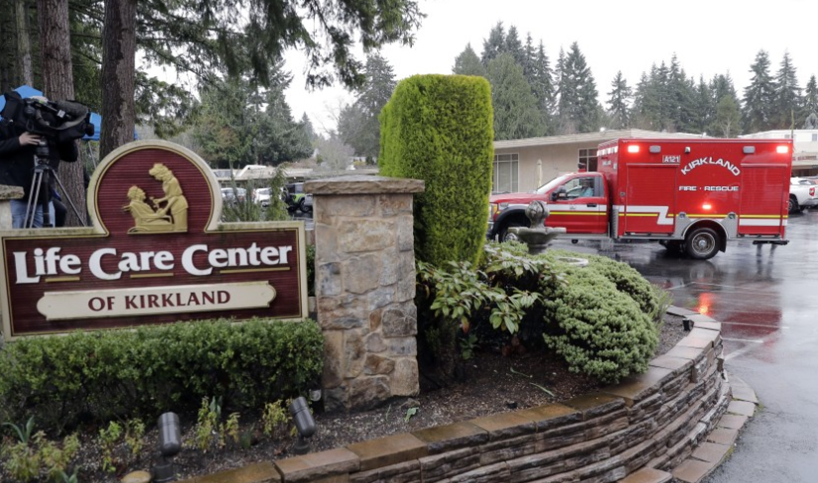
Nursing homes the epicenter of COVID-19
Kirkland Life Care Center
  19 coronavirus deaths
  Dozens ill or hospitalized
  Only 60 of 120 residents remain at Life Care
Notes:
Perhaps most frightening is the potential for nursing homes to become the epicenter of COVID-19 outbreaks in the United States. Given the congregate nature and residents served, nursing home populations are at the highest risk of being affected by COVID-19. On Monday, it was announced that the death toll in Washington state from COVID-19 had risen to 23 with dozens of people reportedly ill or hospitalized. 19 of these deaths had been from one single nursing home, Kirkland Life Care Center in Seattle Washington. Dozens are still ill or hospitalized with only 60 of 120 residents remaining at the facility and deplorable conditions reported with dozens of healthcare workers also ill and unable to report to the facility. We believe that our facilities are behind in our preparations. Actions need to be taken today. This has to be the number one priority for every Long Term Care facility in Maryland. It is paramount that we be prepared to prevent and respond to similar outbreaks at our facilities.

Slide 7

Maryland: COVID-19 Cases and PUI
Number of positive COVID-19 tests: 12
11 travel-associated
1 under investigation
Testing and case counts posted at http://health.maryland.gov/coronavirus
Data current as of March 12, 2020
Notes:
As of March 12t^{h}, 12 patients have tested positive for COVID-19. We will continue to provide updates on the testing and case counts on our website at health.maryland.gov/coronavirus.

Slide 8
Preventing the Introduction of COVID-19
Healthcare workers
  Enforce sick leave policies. Ensure HCP do not report to work ill.
Visitors
  Implement CDC/CMS strict visitation policies
  Non-essential personnel should be restricted
Residents
  Assess for s/s respiratory illness prior to admission
  Evaluate and quickly manage residents with respiratory illness
  Daily close monitoring for respiratory illness
Notes:
To prevent and control COVID-19 in long-term care facilities, we have to prevent the introduction of this virus. Healthcare personnel and visitors are the most likely sources of introduction. Prevention should be focused around ensuring that these two groups do not introduce COVID-19 to the facility. In order to do this, CDC and CMS have recommended aggressive visitor restrictions and enforcement of sick leave policies for ill HCP, even before COVID-19 is identified in a community or facility.

Slide 9
Preventing Employee Introductions
Facilities should actively screen HCWs for the following
  S/S respiratory infection
  Contact with confirmed COVID-19 case
  Travel to areas with ongoing community transmission within 14 days
  Residing in a community with community-transmission of COVID-19
Sick leave policies should be non-punitive and allow sick HCWs to stay home when showing s/s respiratory illness
Staff that develop symptoms while working should immediately stop working, don a mask, and self-isolate
Notes:
Actively monitor! Take their temperatures and DOCUMENT no signs and symptoms of illness. Inform the facility’s infection preventionist, and include information on individuals, equipment, and locations the person came in contact with; and o Contact and follow the local health department recommendations for next steps (e.g., testing). Facilities should be asking their employees to identify where else they work and restrict those employees working at facilities that have active COVID-19 outbreaks.

Slide 10
Preventing Visitor Introductions
Facilities should limit access to include only essential visitation
Facilities should actively screen & restrict visitors w/
  S/S respiratory infection
  Contact with confirmed COVID-19 case
  Travel to areas with ongoing community transmission within 14 days
  Residing in a community with community-transmission of COVID-19
  Visitation should be limited to specific hours
  Offer alternative means of communication for families
Notes:
Explain active versus passive screening

Slide 11
Preventing Resident Introductions
Assess residents for s/s respiratory illness prior to admission
Actively monitor residents daily for s/s respiratory illness
Use standard, contact, and droplet precautions with eye protection for residents with s/s respiratory illness
Immediately report outbreaks of respiratory illness to your local health department
Notes:
I think we should instruct facilities to begin actively monitoring all residents at least daily for fever and respiratory symptoms if not already doing this; if overwhelming, start w/ highest risk units and build out from there; add eye protection to precautions needed for respiratory illness
Actively monitor – take temperature and document

Slide 12
Caring for Residents with COVID-19
Person who resides in a nursing home or long-term care facility AND who has either fever or signs/symptoms of a lower respiratory illness AND who tested negative for influenza on initial work-up AND a respiratory virus panel negative for all pathogens AND no alternative diagnosis
If a facility has an outbreak of COVID-19 they should:
  Further restrict visitation except in limited circumstances
  Implement universal use of facemasks
  Cohort ill residents with dedicated HCP
  Restrict residents from leaving their rooms
Testing for COVID-19 should be done in close collaboration with public health
Notes:
When we have residents with COVID-19, we will not be able to transfer out every resident with COVID-19 unless a higher level of care is needed. We will need to cohort and care for residents in place that do not require hospitalization. Facilities need to prepare their staff and facilities for this today by developing protocols and focusing education on the identification and care of residents with COVID-19. Facilities should contact their local health department when they identify residents with fever or signs/symptoms of a lower respiratory illness who have no alternative diagnosis such as influenza or other viral respiratory pathogens.

Slide 13
Resources
MDH Novel Coronavirus: http://health.maryland.gov/coronavirus
MDH Laboratory Coronavirus: https://health.maryland.gov/laboratories/Pages/Novel-Coronavirus.aspx
COVID-19 People at risk https://www.cdc.gov/coronavirus/2019-ncov/specific-groups/high-risk-complications.html
CDC Coronavirus Prevention & Response in Long-term Care https://www.cdc.gov/coronavirus/2019-ncov/healthcare-facilities/prevent-spread-in-long-term-care-facilities.html
CMS Coronavirus/LTC: https://www.cms.gov/files/document/qso-20-14-nh-revised.pdf
CDC Guidance for Infection Control https://www.cdc.gov/coronavirus/2019-nCoV/infection-control.html

Slide 14
Questions?

